Slide 1


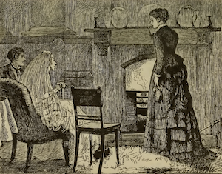

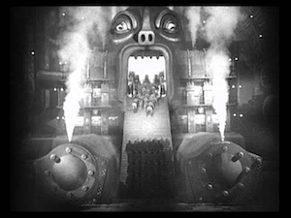


Great expectations about the production and consumption of food
A story of fields, hearths, and digital twins
@ICBO 2025 Nov 14 workshop: Food, Waste and Sustainability: Synergizing Ontology Efforts
Damion Dooley
Ontology Development Lead
Centre for Infectious Disease Genomics and One Health, SFU
Emma Griffiths
Rhiannon Cameron
Anoosha Sehar
William Hsiao & the FoodOn Crew!
Notes:
https://ca.pinterest.com/pin/1548181160135239/
https://www.youtube.com/watch?v=M9fuNWGrX4U
https://www.gutenberg.org/files/1400/1400-h/1400-h.htm

Slide 2
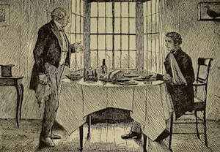
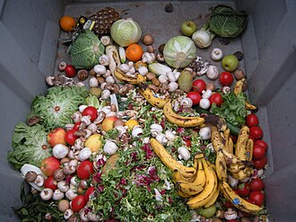
Agenda
Food role
Food waste role
UN Sustainable Development Goals → food system waste
Pre-harvest
Harvest to retail
Retail to household
Process modelling and FoodOn Recipe 2.0
Notes:
https://commons.wikimedia.org/wiki/File:Trashed_vegetables_in_Luxembourg.jpeg

Slide 3
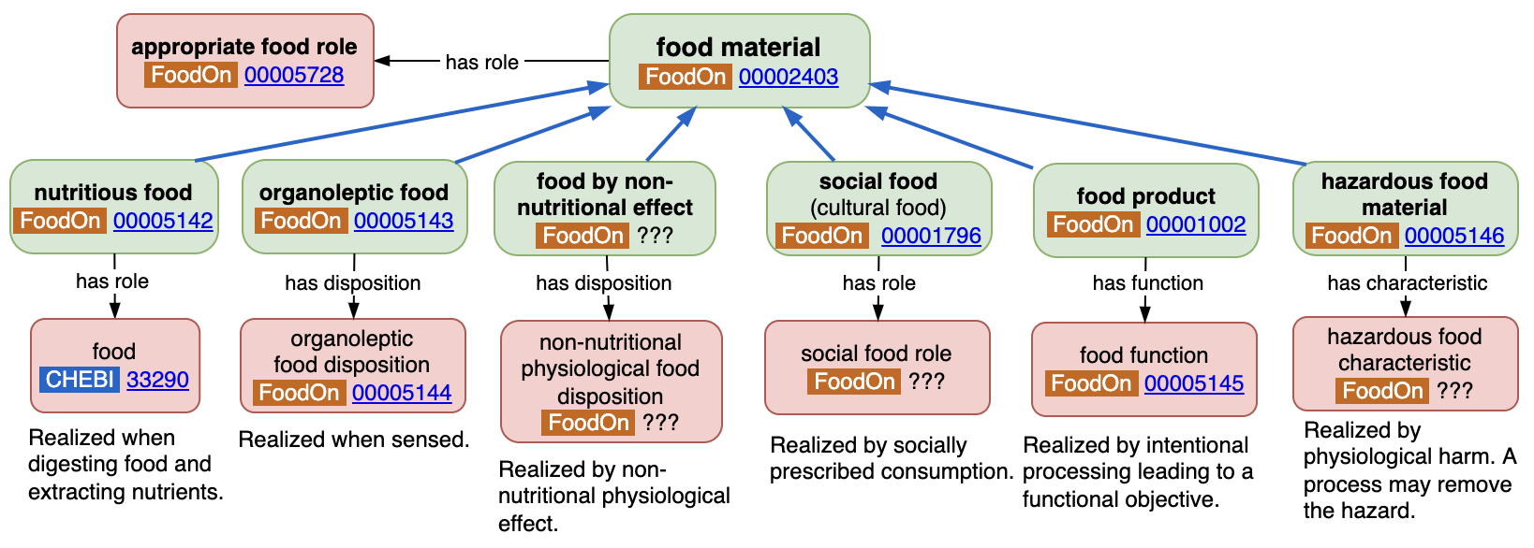
Food role
appropriate food role =def. A role of a material entity of a type that is generally considered by some agent as appropriate for consumption by ingestion in order to fulfill nutritional needs or to provide organoleptic experiences.
Toyoshima & al. “What is food? An investigation into food realizables.” https://ceur-ws.org/Vol-3882/ifow-1.pdf
Notes:
FoodOn “food material”: “Any substance that can be consumed by an organism to satisfy nutritional or other health needs, or to provide a social or organoleptic food experience”
- From Toyoshima & al. “What is food? An investigation into food realizables.” https://ceur-ws.org/Vol-3882/ifow-1.pdf
Edibility : non-hazardous
Nutritiveness
Palatability (organoleptic)
psychoactive experience (non-nutritional physiological effect)
food social experience
Any community of agents defines an “appropriate food role”. E.g. some eat pork; others don’t.
Also: https://www.researchgate.net/publication/395200276_Two_Ontological_Approaches_to_Food_Products
Note: usually we talk about food materials rather than food products since food products just add an intentional expectation (as evidenced by application of some material processing) to a material that can still be evaluated in terms of its food role.

Slide 4
Food waste role
The duration question¹: “when it is that the predicate-schema ‘Is an X -Food,’ where ‘X -Food’ stands for a certain type of food (e.g., Champagne, yoghurt) ceases to apply to an entity?”
If a material has at some point a food role, then thereafter it might take on a food waste role².
Food becomes food loss/waste the moment it can no longer possibly fulfill its intended purpose - to play a food role. This depends on:
the material’s intrinsic disposition
extrinsic entity properties - the distribution system; other environmental conditions, or disposition of consumer
¹A. Borghini, N. Piras, Food identity and the passage of time, Applied Ontology, 17(4), 443-463, 2022.
²Toyoshima et al. Representing food waste in ontologies: A role-based account. JOWO 2025 CEUR Workshop Proceedings (forthcoming).

Slide 5
Food waste role - a production or consumption perspective?
food waste role: SubClassOf [realized_in not (realizes some appropriate food role)]
consumption product role: “A role to be realized in a planned process in which the bearer is consumed.”
food waste role: SubClassOf [realized_in not (realizes some consumption product role)
Points of failure:
Failure of food material to be the adequate subject of the food role
e.g. sparse, stunted or bad apples
Failure of extrinsic processes to store, preserve, access or transform food
e.g. no grain storage, too expensive, too far, toxic, no harvester, dryer, oven, or can opener
Failure of extrinsic organism to consume food
E.g. requires liquid feeding, unpalatable, allergic reaction

Slide 6
UN Sustainable Development Goals - food supply
#2: Zero Hunger
Target 2.4: Ensure sustainable food production systems and implement resilient agricultural practices [...] that strengthen capacity for adaptation to climate change, extreme weather, drought, flooding and other disasters […]”
Indicator 2.4.1 Proportion of agricultural area under productive and sustainable agriculture .(FAO)
#12: Sustainable consumption and production patterns
Target 12.3: Reduce food losses along production and supply chains, including post-harvest losses Indicator 12.3.1a: Food loss index (FAO)
The crop and livestock human-edible commodity quantities that, directly or indirectly, completely exit the post-harvest/slaughter production/supply chain (I.e. no other utilization such as animal feed, glue etc), up to and excluding the retail level.
Target 12:3: Halve per capita global food waste at the retail and consumer levels
Indicator 12.3.1b: Food waste index (UNEP)
The Food Waste Index tracks the global and national generation of food and inedible parts wasted at the retail and consumer (household and food service) levels.
Notes:
https://unstats.un.org/sdgs/report/2025/extended-report/Extended-Report-2025_Goal-2.pdf

Slide 7
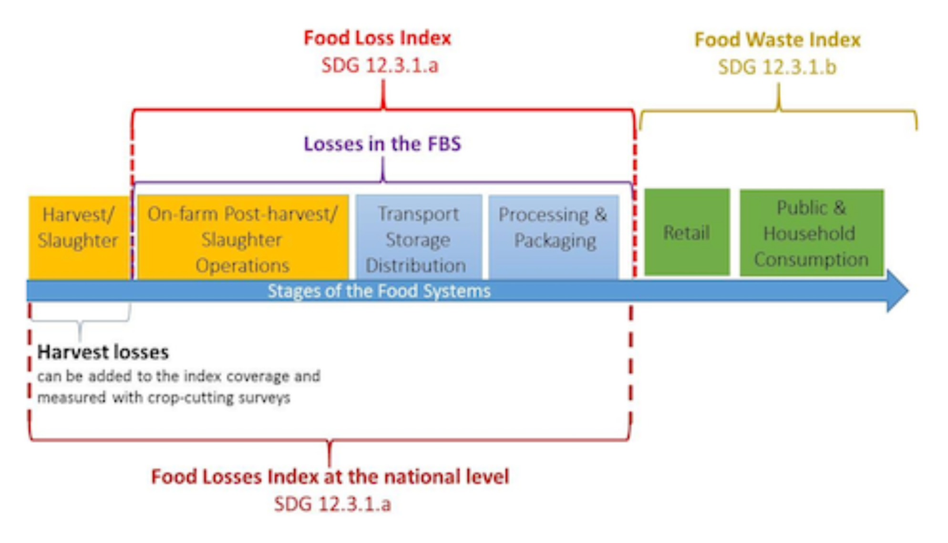
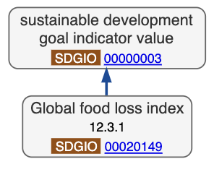
Food supply chain - production, post-harvest and retail segments
“Food waste” is defined as food and the associated inedible parts removed from the human food supply chain by retailers, food services and consumers.
Commodities (food loss only)
1. Cereals & Pulses 2. Fruits & Vegetables 3. Roots & Tubers and Oil-Bearing crops 4. Animal Products 5. Fish and Fish Products
Source: https://wedocs.unep.org/handle/20.500.11822/45230
Notes:
Food waste definition: https://wedocs.unep.org/handle/20.500.11822/45230 … Borghini et al. [2] state: “This distinction [between food loss and food waste] is typically drawn in terms of the
early stages (food loss) and final stages (food waste) of the food chain. But, what counts as
early or final is often underdetermined too. Should we regard a food with a short shelf life,
which goes unsold and hence expired in a supermarket, as a food loss (emphasizing the
responsibility of the producers) or a food waste (focusing on the choices of the consumers)?
[2, p. 858]

Slide 8
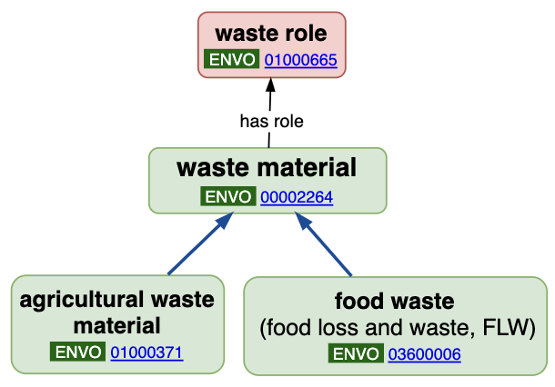
ENVO Waste
A role that is realized in some process wherein the bearer is discarded or not utilized further.
A material which is not the desired output of a process and which is typically the input of a process which removes it from its producer (e.g. a disposal process).
A waste material which is primarily composed of uneaten food and removed from the food supply chain.
Agricultural waste is waste produced as a result of various agricultural operations. It includes manure and other wastes from farms, poultry houses and slaughterhouses; harvest waste; fertilizer runoff from fields; pesticides that enter into water, air or soils; and salt and silt drained from fields.

Slide 9
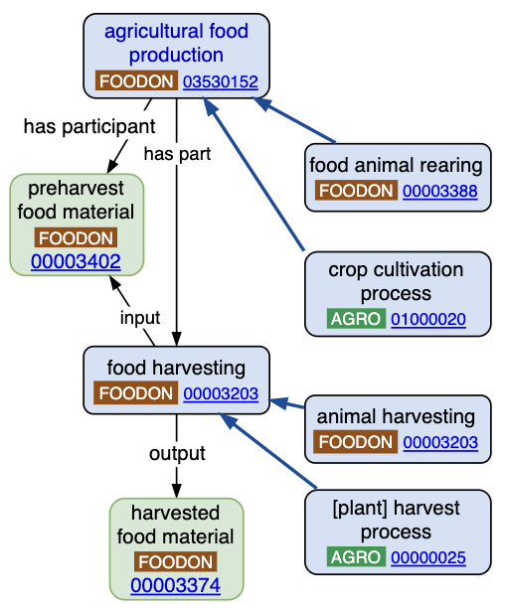
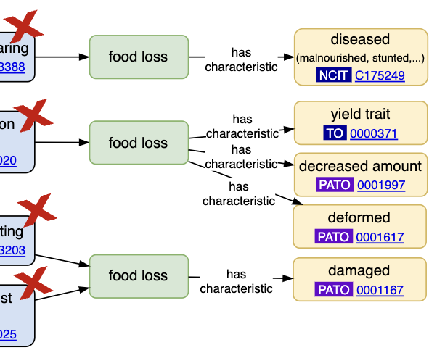
Food supply chain - pre-harvest expectation vs. reality
Should we have a term dedicated to the failed expectation of agricultural production ~= food loss?
The role of crop yield or animal growth / health is influenced by weather (water, hail, storm, heatwave, drought), soil quality, cultivation and animal rearing techniques, and the more general weather patterns induced by climate change.

Slide 10
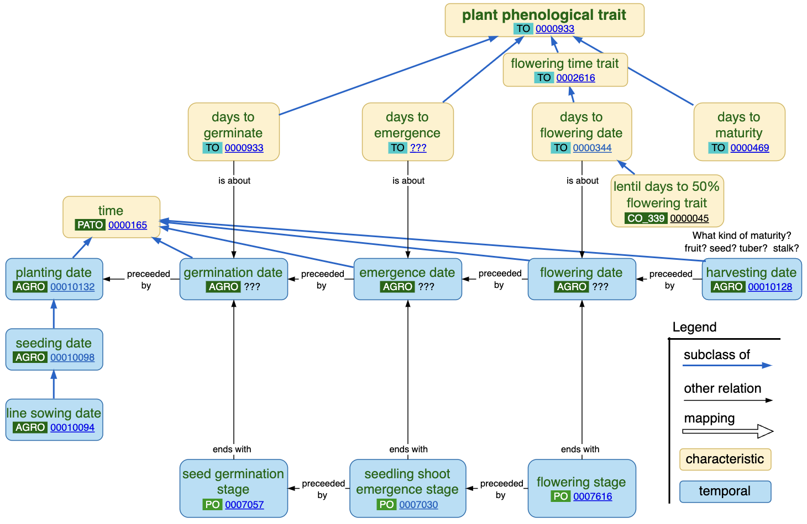
Plant life cycle model
Looking at the metrics available to determine normal vs. abnormal plant growth.

Slide 11
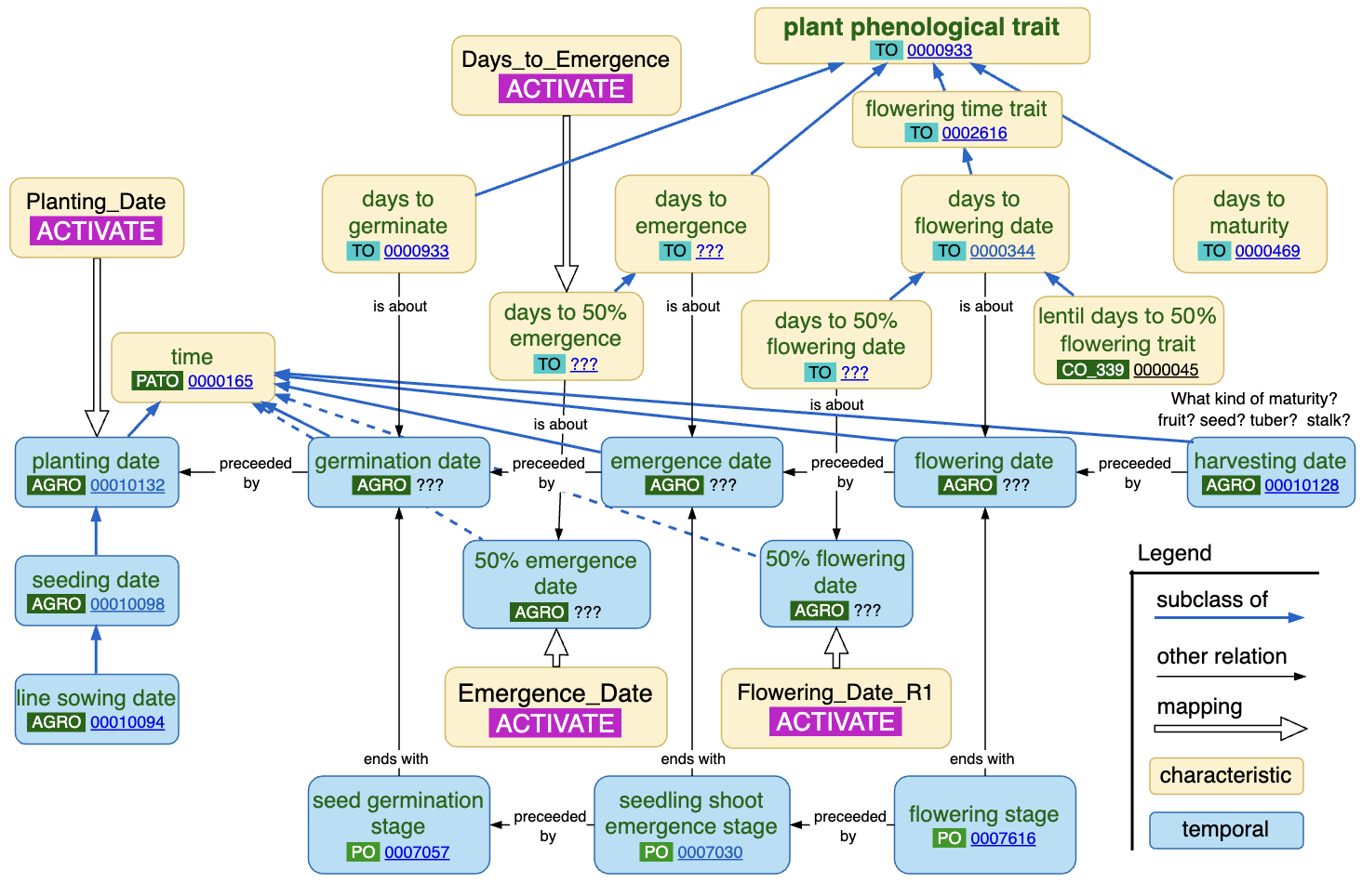
ACTIVATE → plant life cycle
ACTIVATE: “In the face of a changing climate, researchers will develop new resilient crop varieties that require less synthetic nitrogen and are more efficient at translating CO2 into grain yield.” (link)
Notes:
https://genomecanada.ca/project/activating-genomics-to-accelerate-climate-smart-crop-delivery/

Slide 12
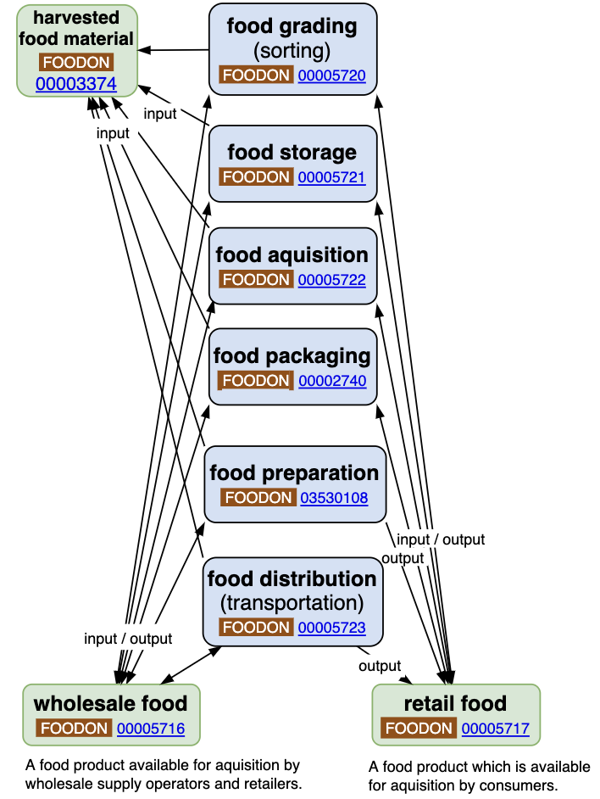
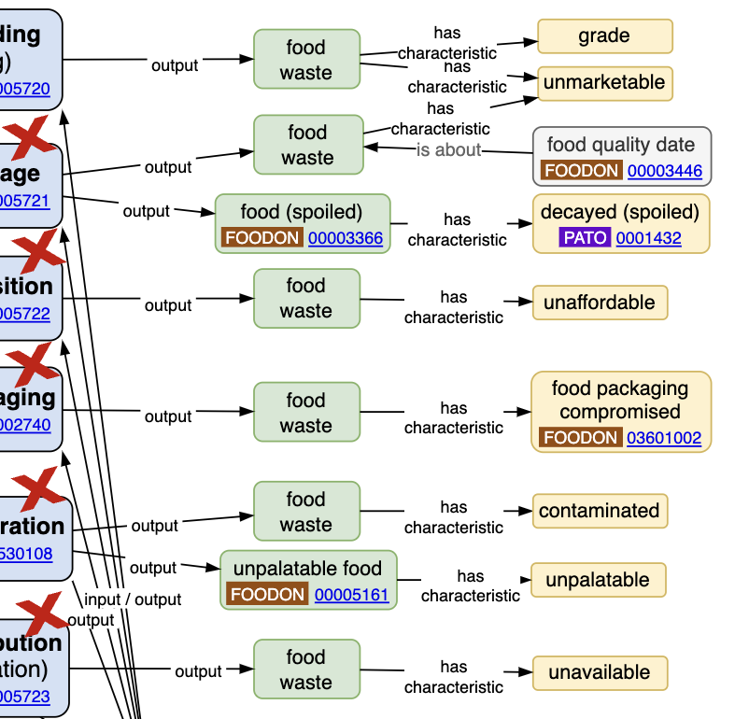
Food supply chain - post harvest
Post-harvest food material can be stored, prepared (combined, separated, preserved, cooked, … ) and exchanged in many stages before arriving in a retail or household context.
Waste or “sidestream” material may exist in both successful AND failed processes.
Technology or knowhow limits may block any process, leading to waste.
Notes:
https://www.sfu.ca/sfunews/stories/2025/05/the-hidden-bias-driving-food-waste--why-healthy-foods-are-more-l.htm - A “lay theory that healthy food expires more quickly”. “best-before” / “best if used by”, → “produced on” + “consume by” … Farm -> Transport -> Storage -> Wholesale -> Processing

Slide 13
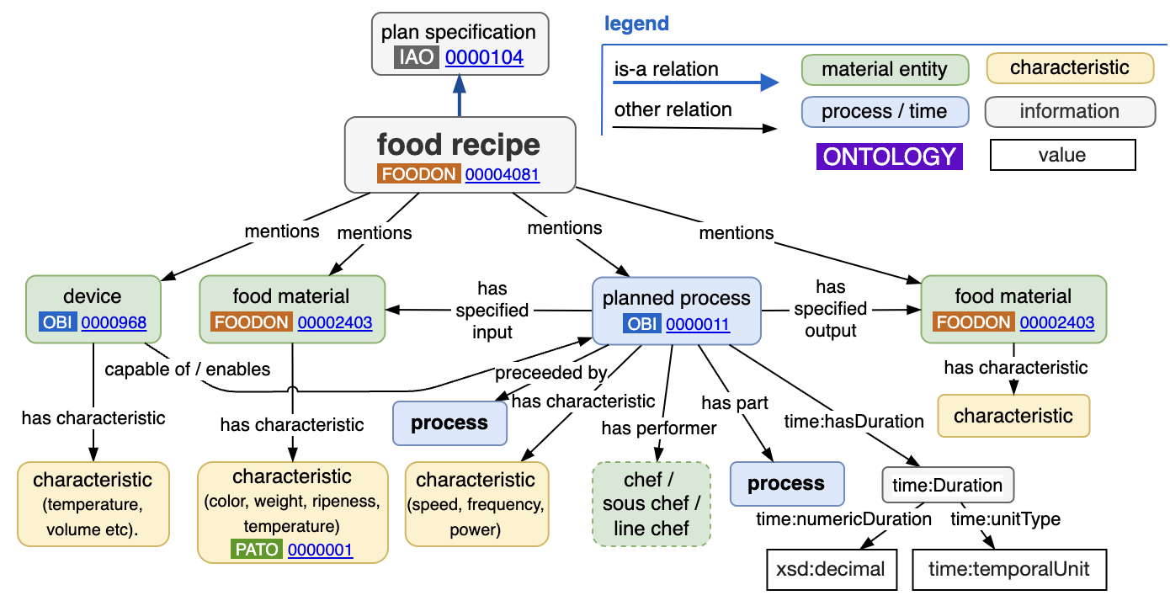
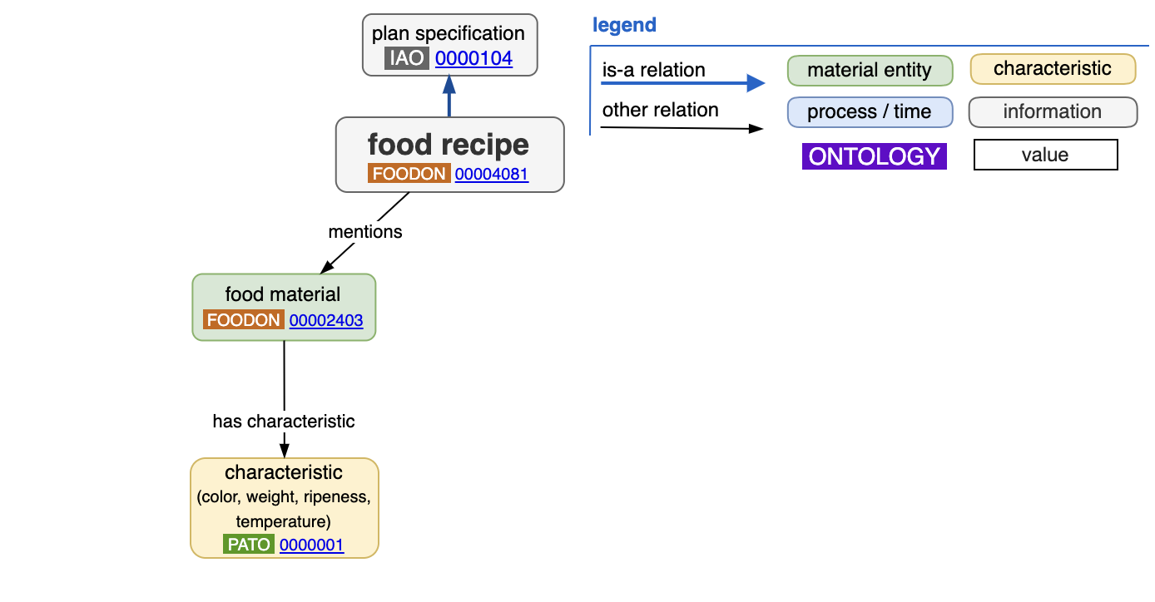
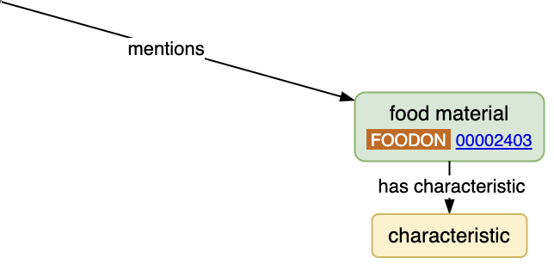
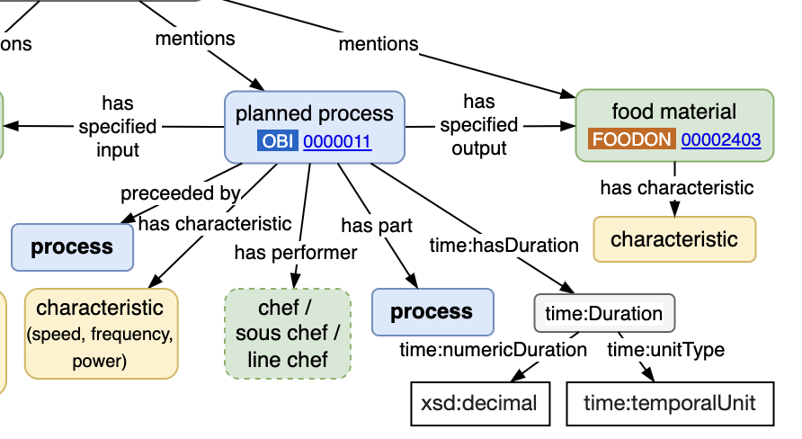
FoodOn Recipe 2.0 process model
An OBO Foundry based process model that generalizes to other manufacturing and distribution activities.
Ingredients
Objective

Slide 14
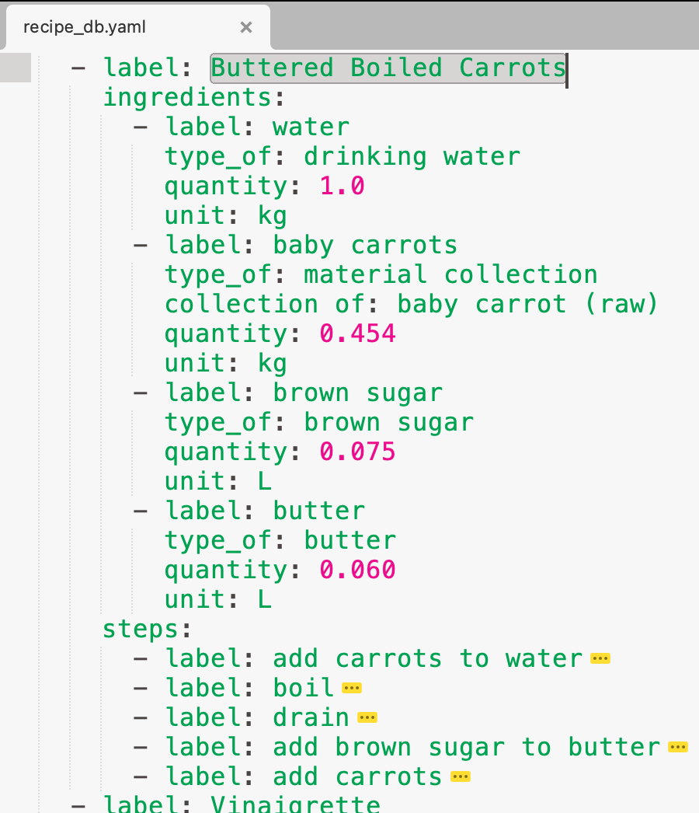

Buttered Boiled Carrots
The recipe process model precision bridges both household recipe and scalable industrial formulation.
It enables household recipes and industrial formulations to detail the usually implicit “cleanup” process, and to document “sidestream” food materials which might otherwise be wasted.
Projects like SIDEAID aim to provide a database of reusable sidestream food materials.
Notes:
https://www.allrecipes.com/recipe/18256/buttery-cooked-carrots/ LWV23105 SIDEAID - AI-based Decision Support for Side Stream Valorization (TS-02-216-017) - Wageningen University & Research

Slide 15
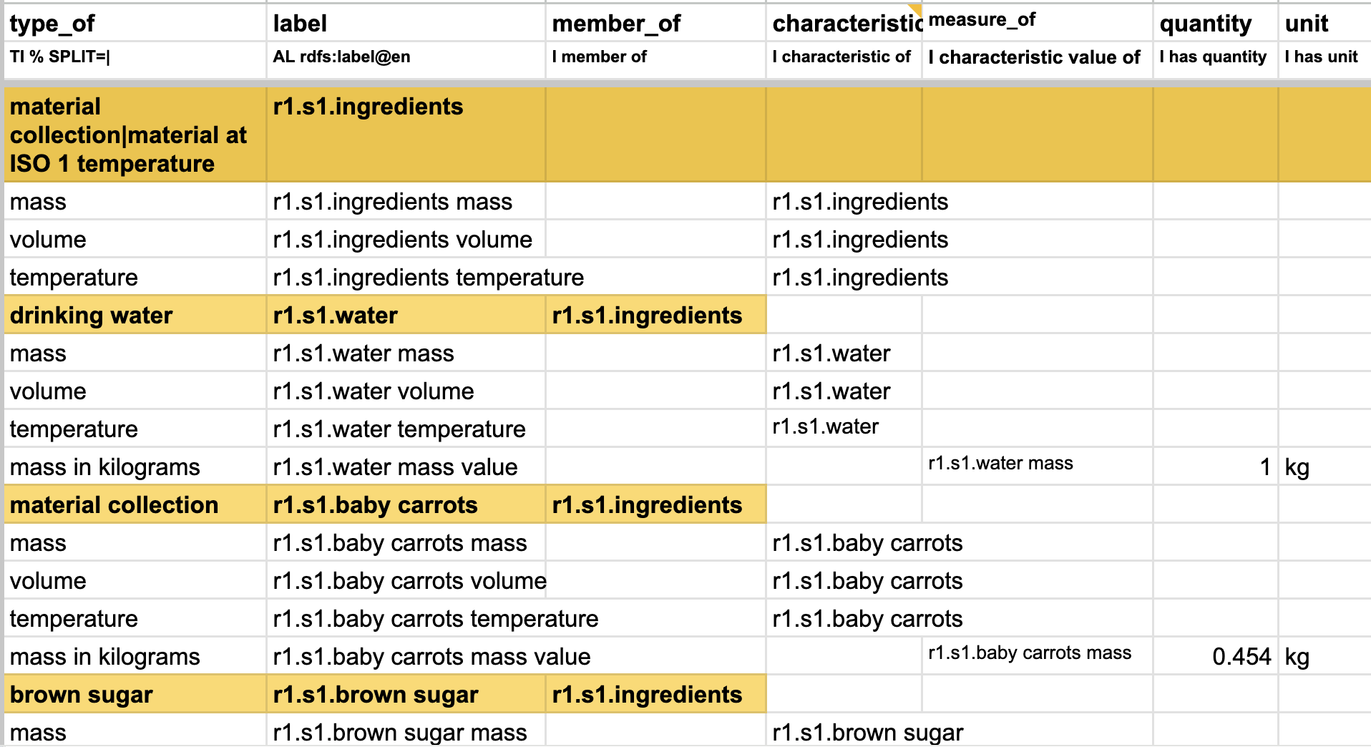
Boiled Carrots - ingredients
Each ingredient is given an identifier relative to recipe (r1), and initial state (s1)
An ingredient potentially has a mass, volume, and temperature. Measured in standardised UCUM units. L, kg, Cel, min Ingredient-to-ontology term in FoodOn, OBI, etc. is matched via type_of

Slide 16
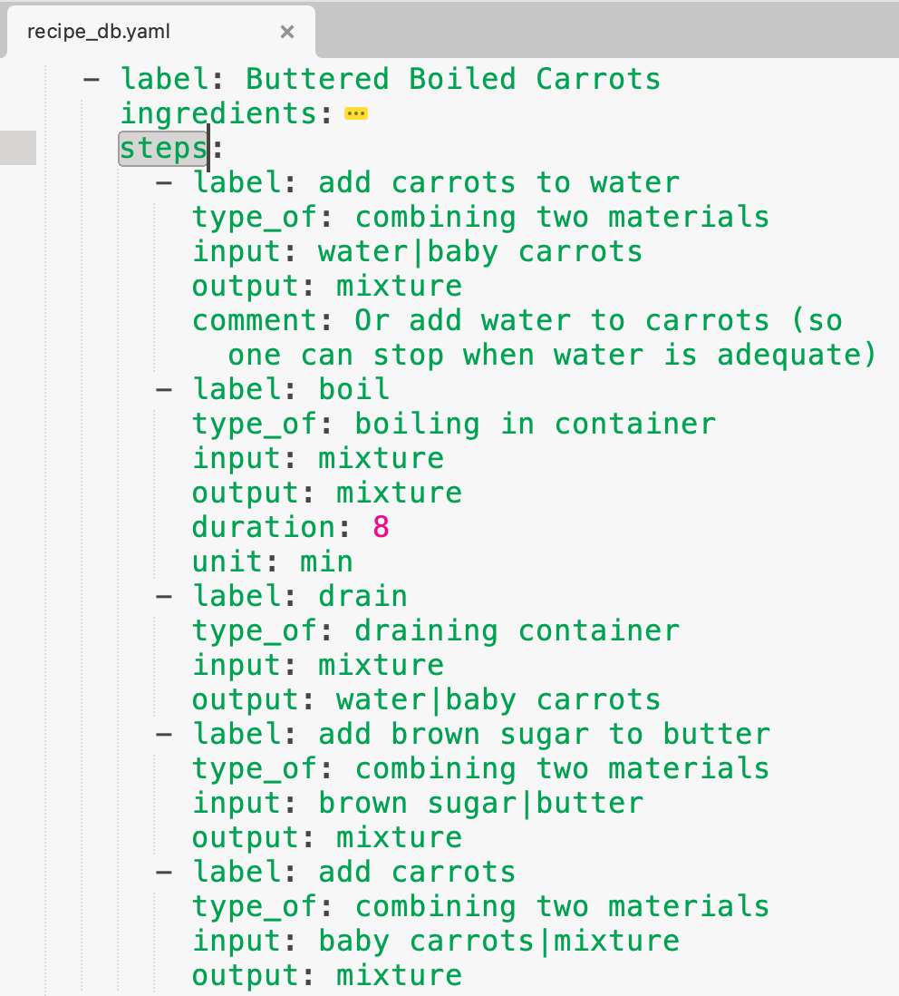
Buttered Boiled Carrots - instructions
Gather all ingredients.
Cook carrots in a large pot of boiling water until tender, about 8 to 10 minutes.
Strain carrots, leaving just enough of the cooking water to cover the bottom of the pan; set carrots aside.
Stir in brown sugar and butter; simmer and stir until butter melts.
Return carrots to the pot and toss to coat. Cover and let sit for a few minutes to allow flavors to mingle.

Slide 17
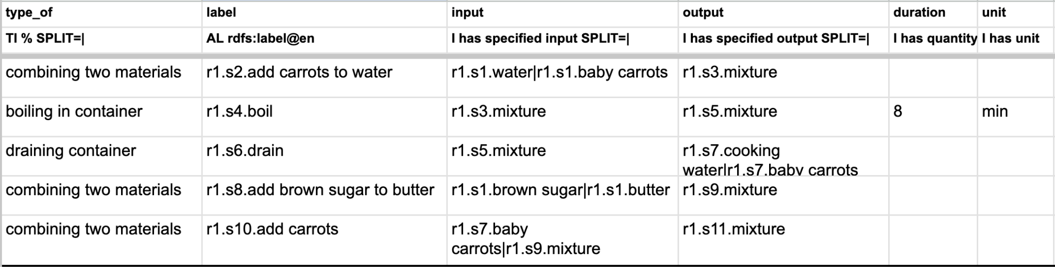
Boiled Carrots - steps
Handle process references to “mixture”:
If in an “output”, it is converted into a new mixture instance with an ID that includes output state.
If in an “input”, then by default the most recently created state “mixture” is searched for.
Notes:
Infer “preceeded by” for all p - i - p hops

Slide 18
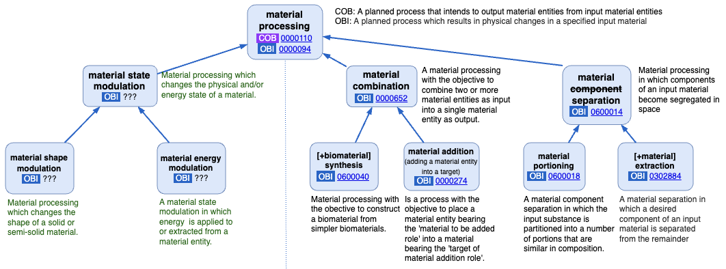
OBI material processing hierarchy

Slide 19
A food-waste definition should account for …
Reversibility: items that may later be reclassified as non-waste.
Relationality: specific relations that render any item food waste.
Possibility: specific likelihood that each item has to become waste.
Vagueness: items whose status as food waste is sometimes undetermined.
Value-sensitivity: values involved in regarding something as food waste.
Agentivity: different kinds of agents involved in the production of food waste. Those agents can be aware or unaware, identifiable or unidentifiable, human or non-human;
Exceptionality: exceptional cases in which the term takes on a different meaning and does not apply to commonly wasted items.
Luck: actors beyond human control that are not predictable and thus unavoidable
A. Borghini, N. Piras, Semantic and philosophical approaches for advancing the identification and measurement of food waste, Nature Food, 2025. https://doi.org/10.1038/s43016-025-01167-2
Notes:
https://pmc.ncbi.nlm.nih.gov/articles/PMC11241329: Impact of Food Waste on Society, Specifically at Retail and Foodservice Levels in Developed and Developing Countries
https://www.sciencedirect.com/science/article/pii/S0301479719308461: Development of a pragmatic framework to help food and drink manufacturers select the most sustainable food waste valorisation strategy
(Food Alternative uses)

